Slide 1
Facilitation Design
Deb Burnight and Nancy Jackson

Slide 2
Welcome
Our intents:
Share a framework for design
Review some tools that are out and about our network
Hear about your experiences (and share ours) and well as answer questions

Slide 3
What are your expectations for this workshop and questions about design?
?

Slide 4
The Design Framework
Session Preparation
Information gathering
Agenda design
People/client, materials and space considerations
Set-up
Session Design
Reporting and Delivery

Slide 5
ICA ToP Competencies - Design
1.2 Create Appropriate Designs – Design customized constructs toward a quality product drawing upon a variety of methods, applications and resources
Can draw upon a variety of methods, applications and resources and determine which to apply
Uses “ORID” as an underlying pattern to create designs

Slide 6
ToP Competencies – All about Design
Manage Positive Client Relationships
Create a Participatory Environment
Evoke the Creativity of the Group
Use ToP Methods Effectively
Model Positive Professional Attitude
Orchestrate Quality Events
Produce Effective Results

Slide 7
Design Prep – It’s about asking good questions
Who
Aims
Culture
History
Current realities
Logistics
Outcomes
Products

Slide 8
Qualifying Questions
ORGANIZATION_____________________________
ATTENDEES:_______________________________
1. What is now working well?
2 What are your current strengths? (What do you have you can build on?)
3. Where are you currently challenged?
4. What has worked well in the past?
5. What have your historical challenges been?
6. What would you like to accomplish with this planning project? (How do you hope your organization will be different when your plan is implemented?)
7. What would you like to have in place in 5 years?

Slide 9
Design Prep: A Fountain of Considerations
Information gathering – design session (lots of good questions, listening)
People/client negotiations
Facilitation style consideration
Aims: Journey
Participants – who is in the room
Agenda design
Props, IT, materials & writable surfaces
Atmosphere, space considerations & set-up

Slide 11
CREATING AN EXPERIENTIAL AIM
The Experiential Aim refers to the inner impact the leader wants the conversation to have.
It describes the way the group will be different by the end of the conversation. You are describing things like mood, motivation and state of being; so you can create the appropriate conditions for them. Steps:
Review Work on the Rational Aim Begin looking at this by focusing on the basis of the conversation at hand.
Review the Experience of the Participants How the participants relate to the topic and to each other is the key to this step.
Determine the Needs of the Group Look at the mood, motivation and state of being that you would like to see in the group at the end of the conversation.
Create the Experiential Aim The experiential aim draws these together in a sentence.

Slide 12
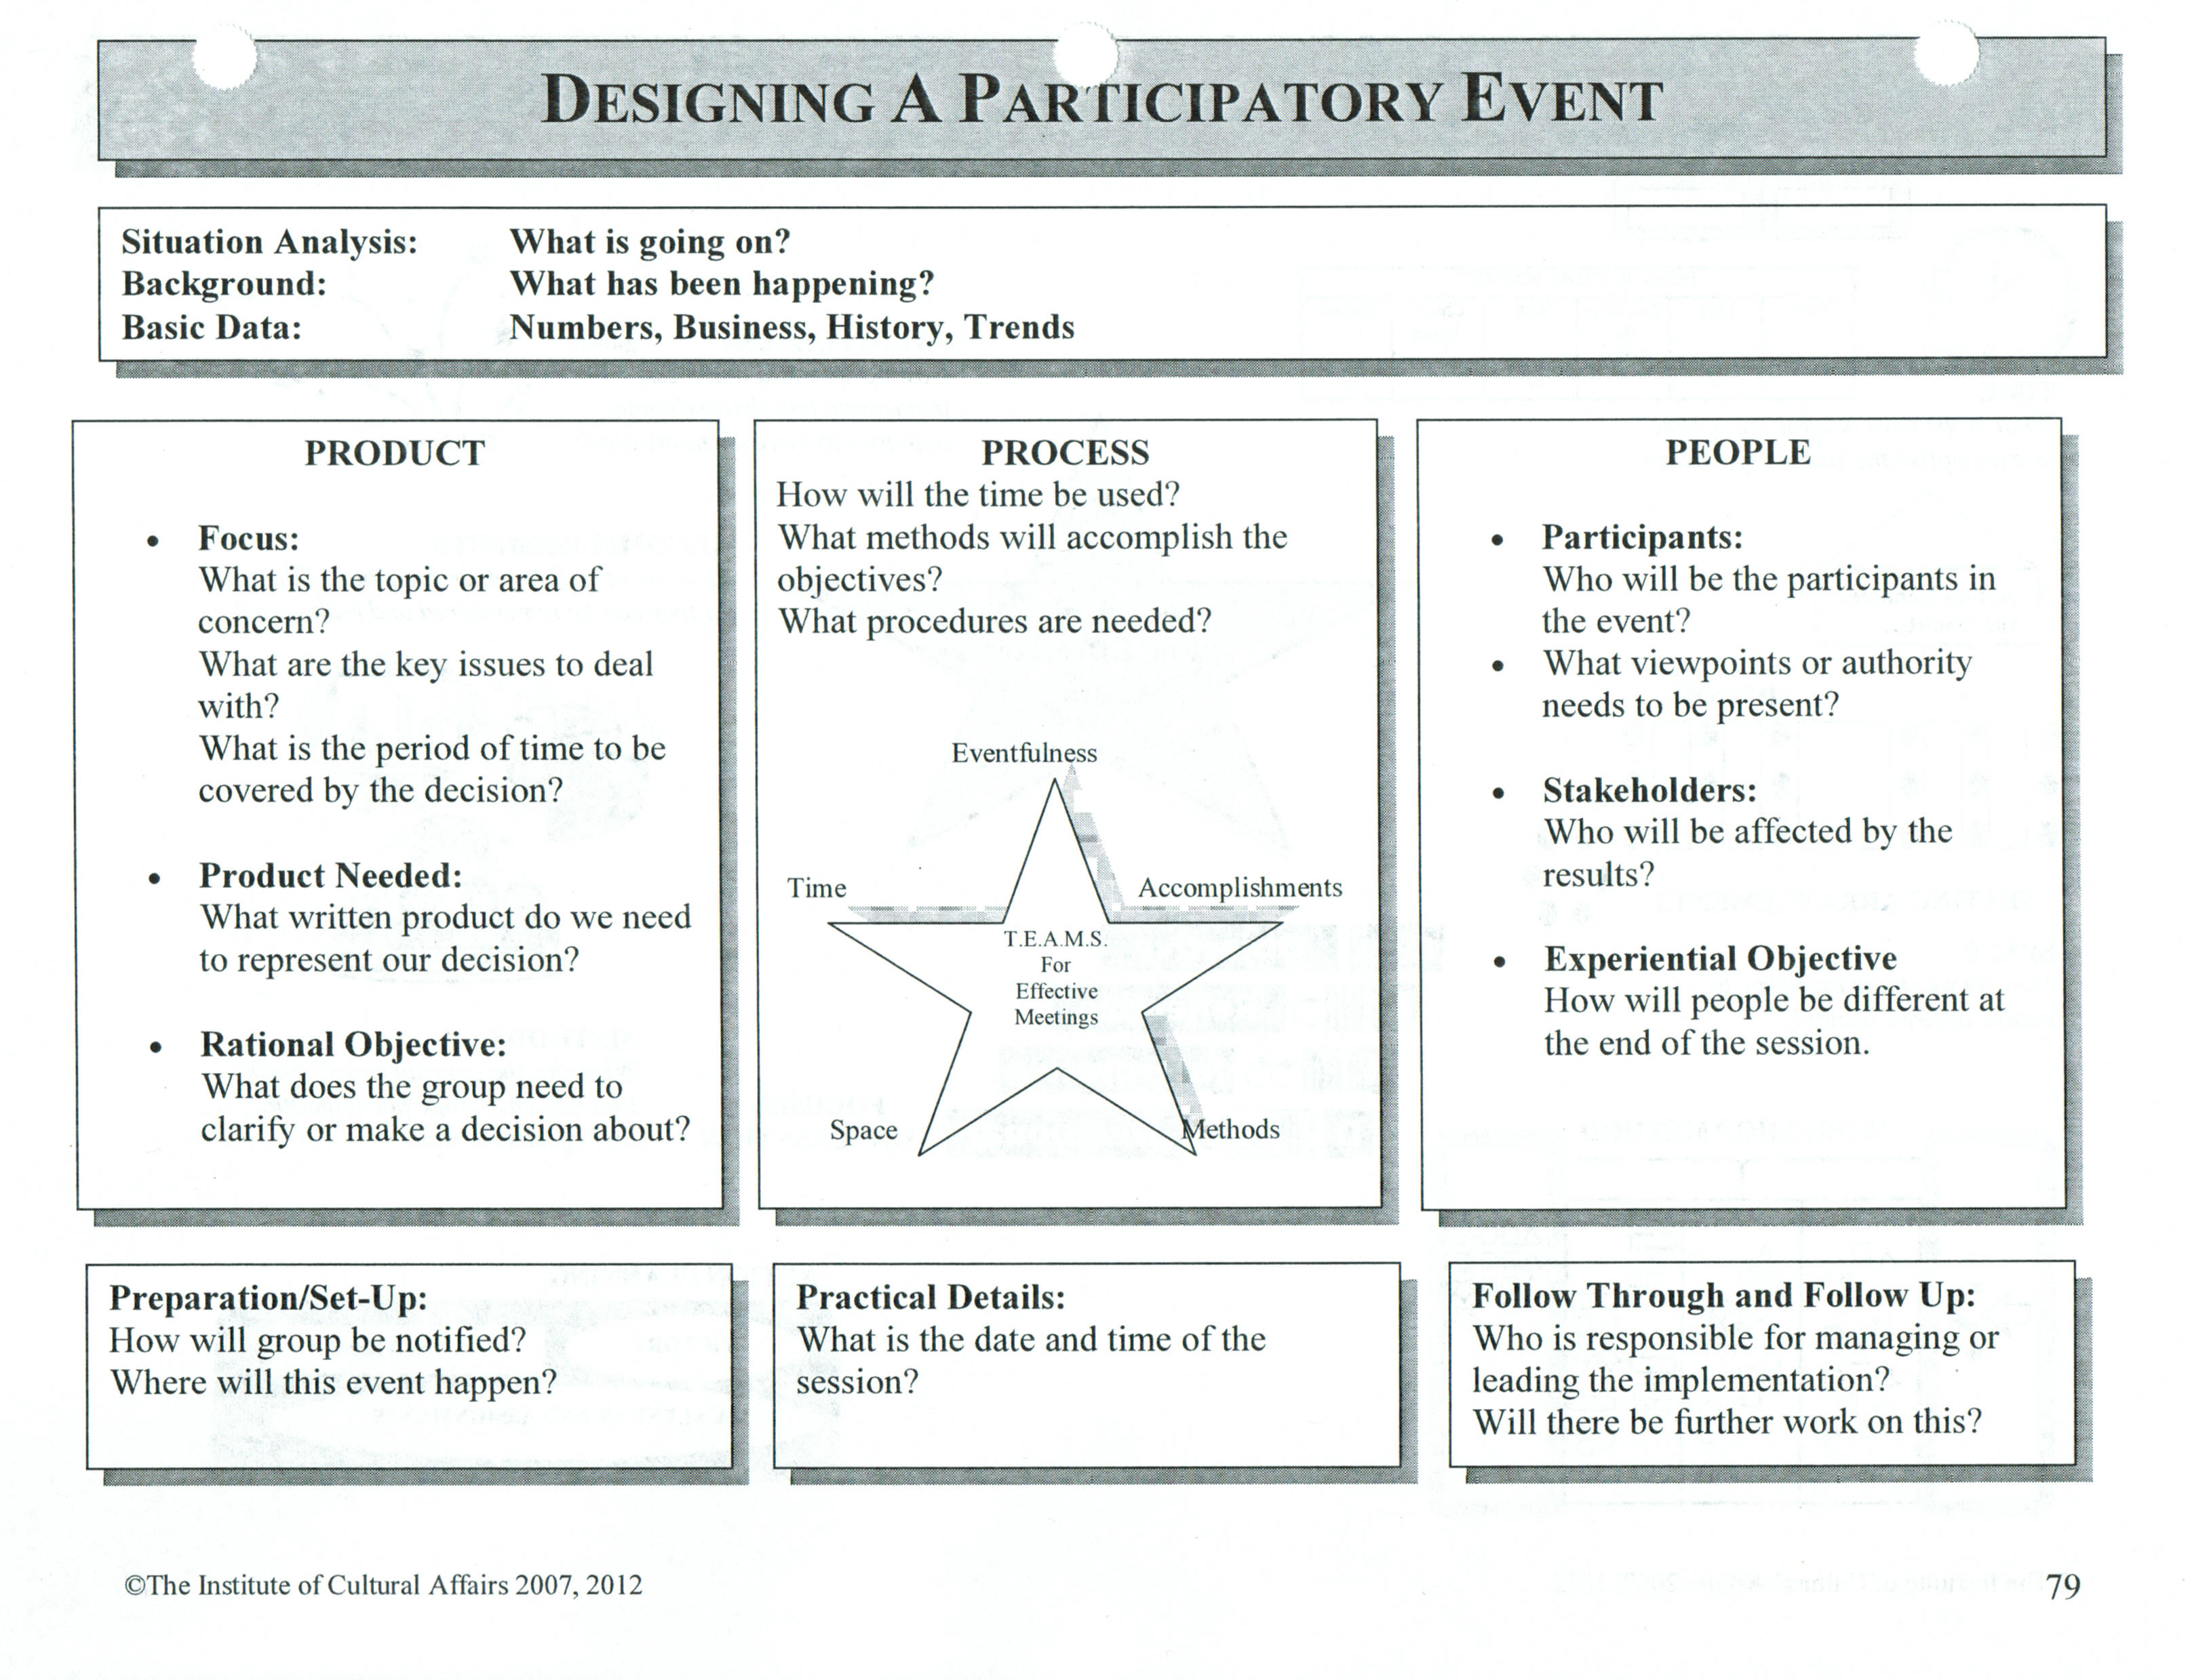

Slide 13
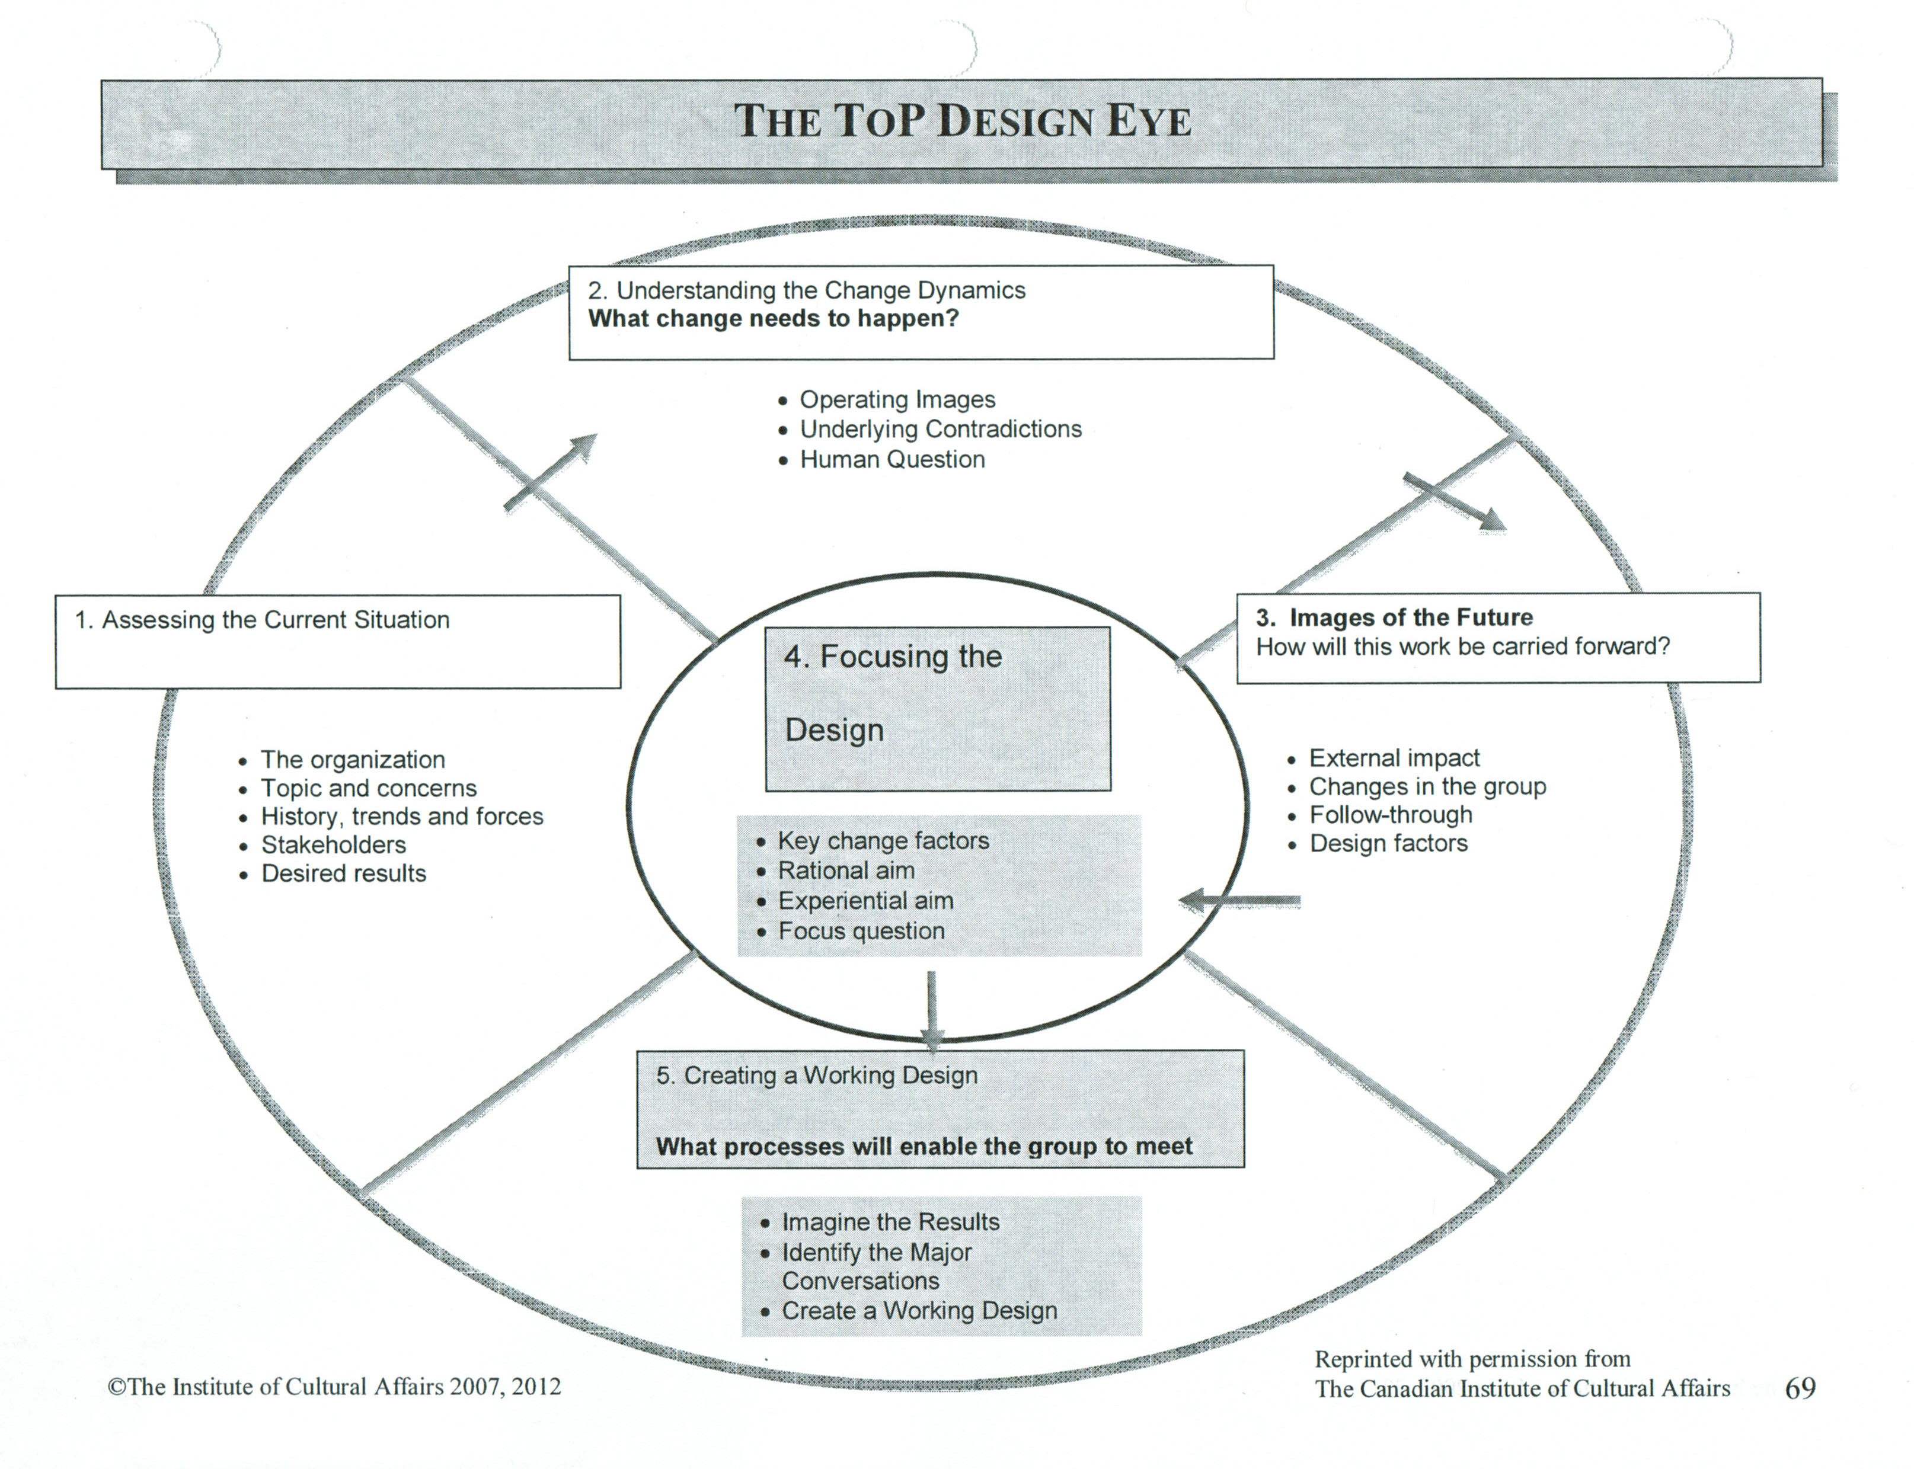

Slide 14
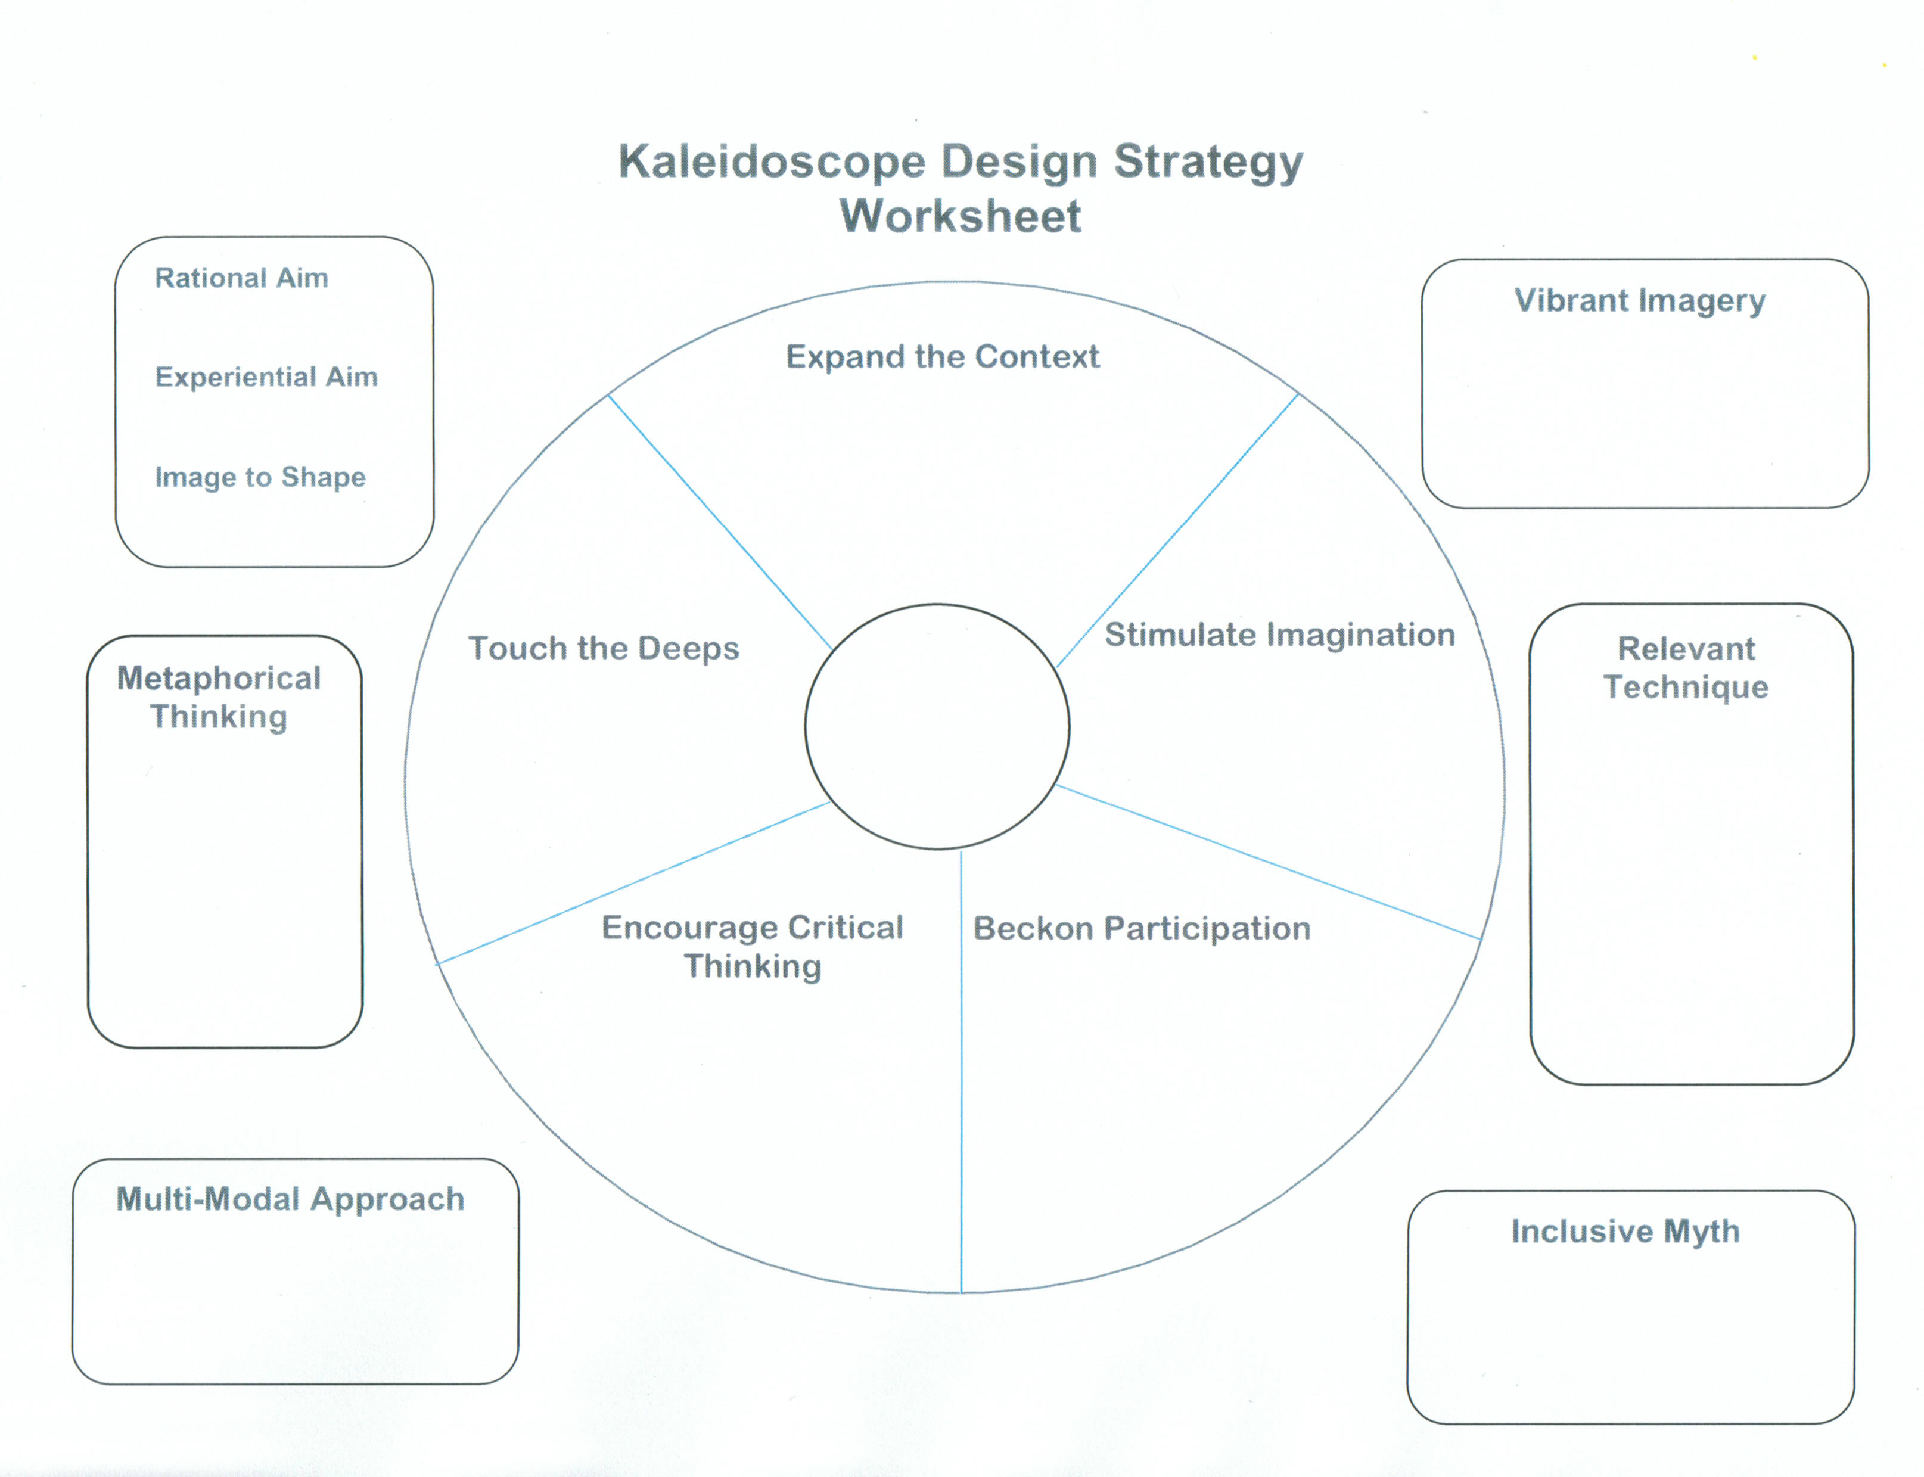
©ICA Sept. 1999 The Power of Image: Tools for Creative Facilitation

Slide 15
Session Design Options
Information Gathering
Information Sorting & Building
ToP Focused Conversation
Circles of Influence
Fishbowl
Social Network Webbing
Use of metaphor (e.g. postcards)
Carousel/Walk About
15% Solutions
Ethnography
Wicked Questions
ToP Consensus Workshop
Storyboards
Open Space
World Café
Conversation Café
Shift and Share
ToP Victory Circle thru Commitments
Scenario Building or Critical Uncertainties
Integrated ~ Autonomy

Slide 16
Session Design Options
Information Gathering
Information Sorting & Building
Wise Crowds
9 Whys
1-2-3-All
Stakeholder Mapping
Matrices – Agreement-Certainty Matrix
25-To-15 Crowd Sourcing
Idea elimination/advocacy
ToP Trends WAVE

Slide 17
Design Element Resources
www.liberatingstructures.com
https://methodkit.com

